Slide 1
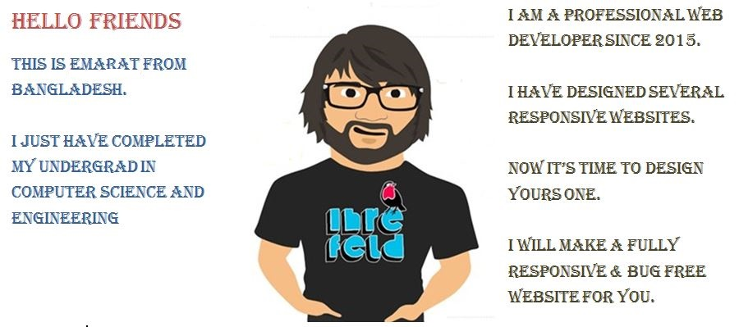

Slide 2
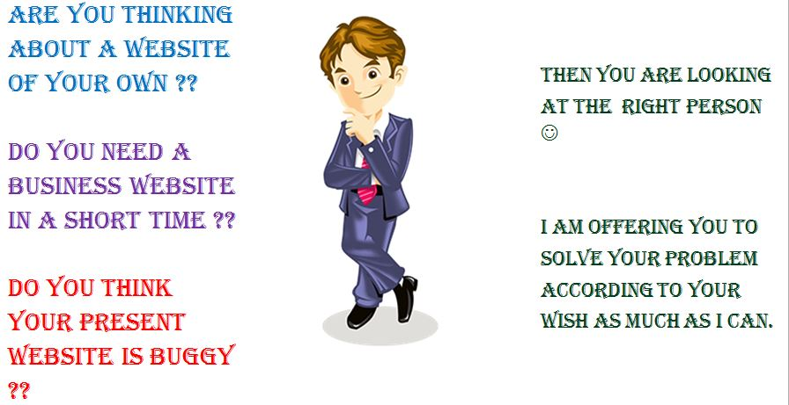
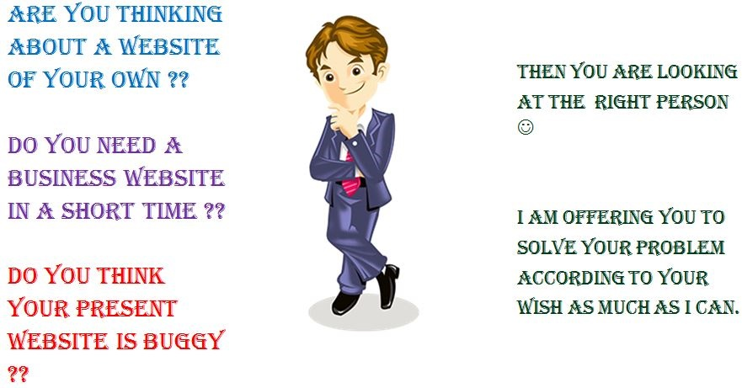

Slide 3
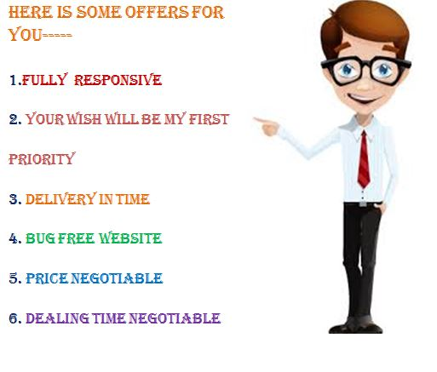

Slide 4

IF YOU HAVE ANY ISSUE REGARDING YOUR WEBSITE

Slide 5
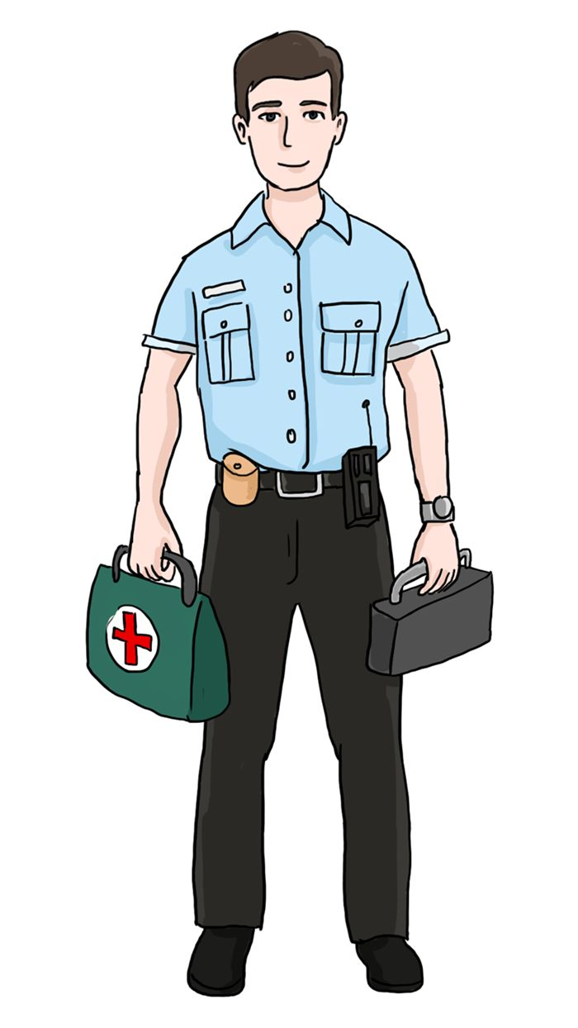
LEt’S DO THIS MY FRIEND ☺ I AM READY TO FIX YOUR WEBSITE

